Slide 1
Atari Pong with DQN
Rahil Makadia

Slide 2
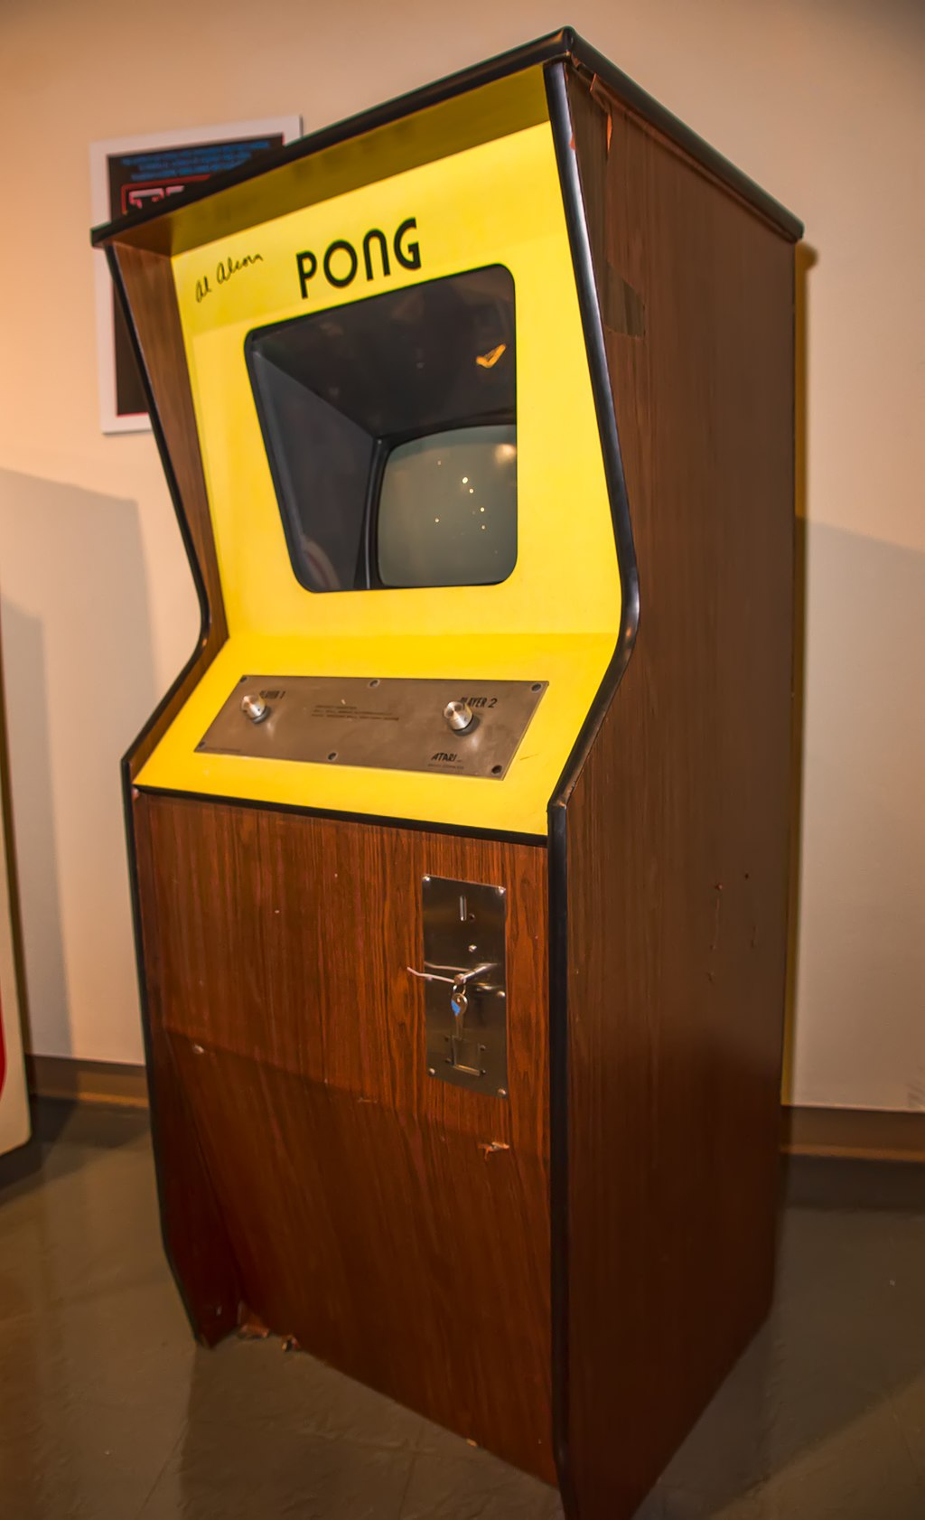
Introduction
Table tennis-themed game from the 70s by Atari
OpenAI gym environment for the same.
Training done using the Deep Q-Learning Algorithm¹
Credit: Chris Rand / Wikimedia Commons
¹Mnih, V., Kavukcuoglu, K., Silver, D. et al. Human-level control through deep reinforcement learning. Nature 518, 529–533 (2015).

Slide 3
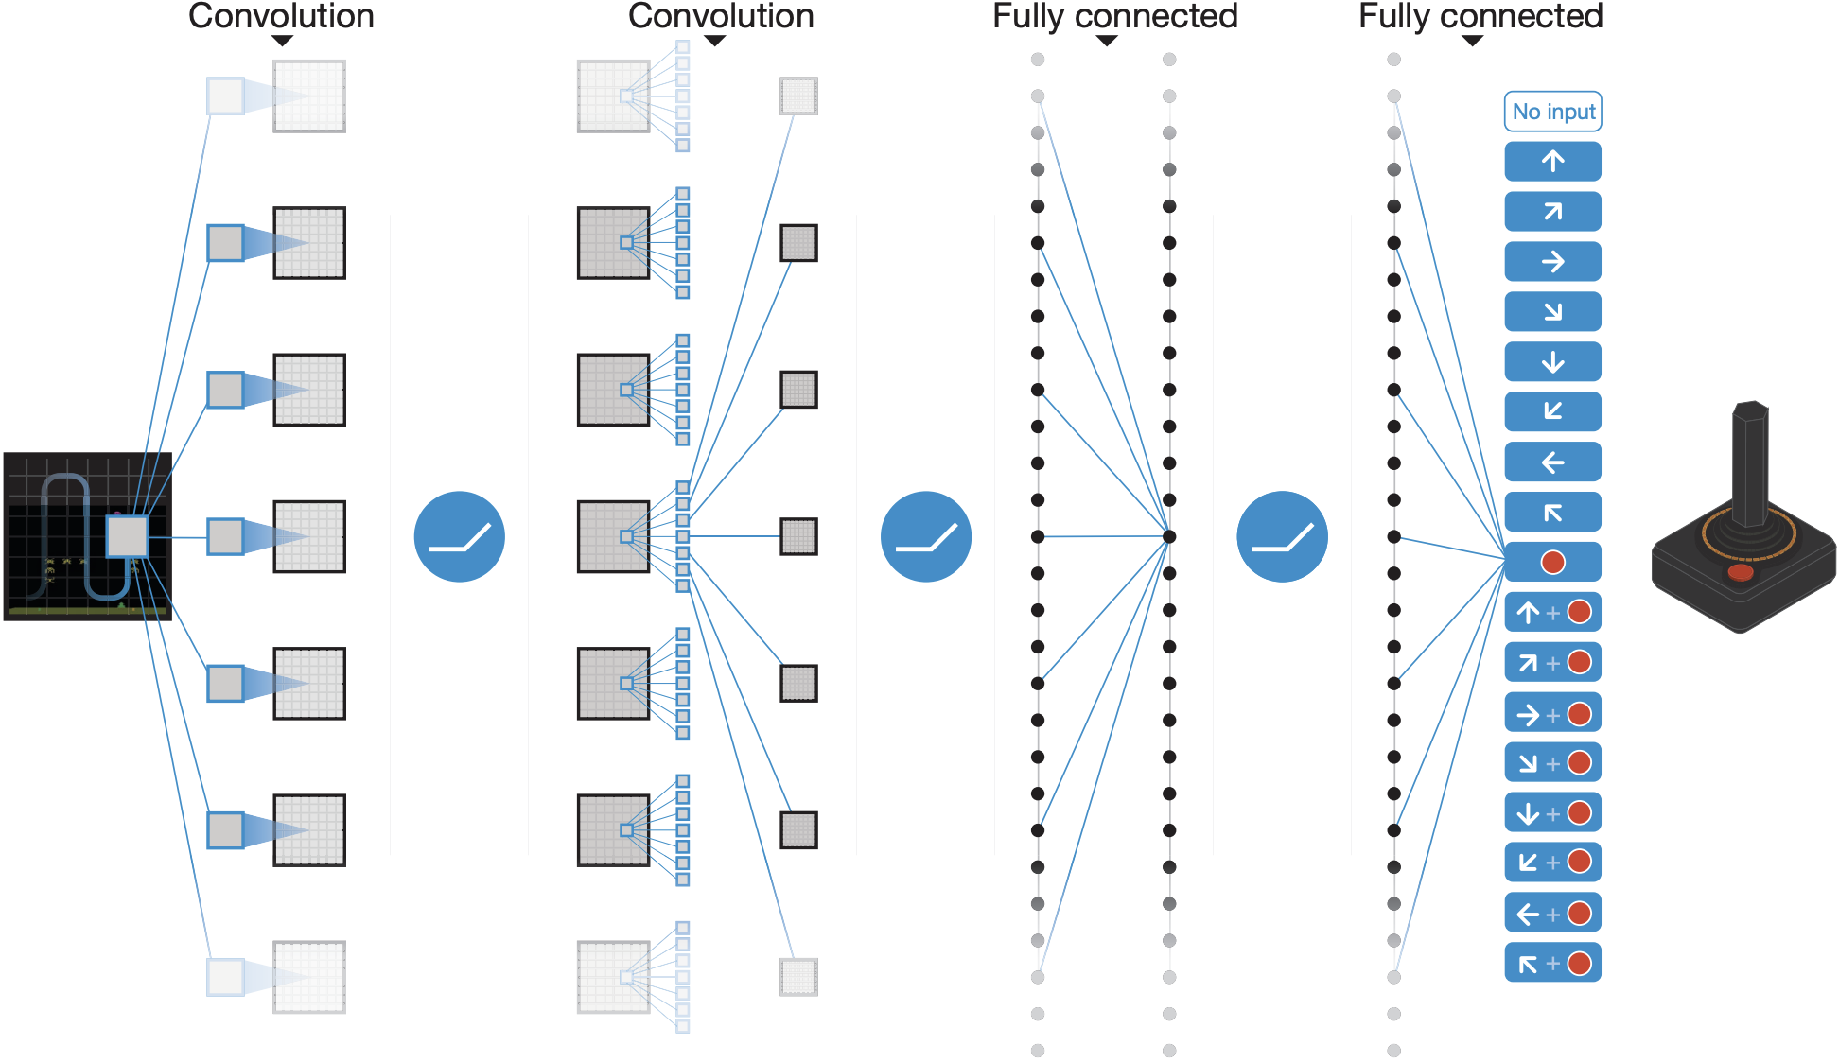
DQN overview – again :)
Credit: Mnih et al. [1]

Slide 4
Hyperparameters
Parameter | Value
Batch Size | 32
Discount Factor (γ) | 0.99
Exploration Factor (ε) | 1.0 → 0.02
Learning Rate | 0.0001
Initial Memory Size | 10,000
Memory Size | 100,000
Target Update | 10,000

Slide 5
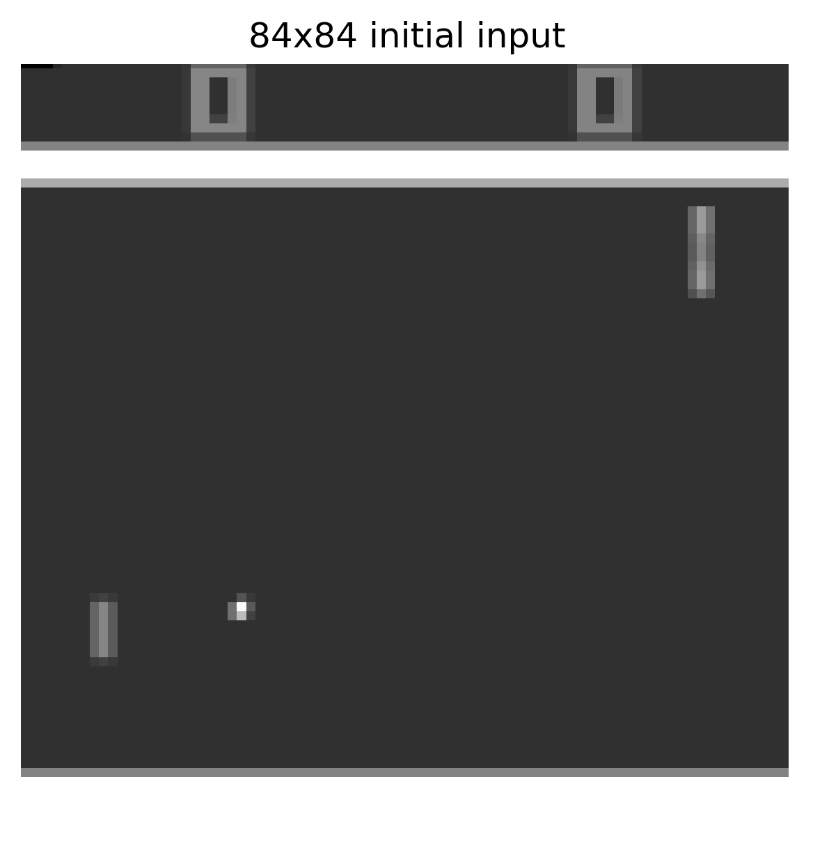
Preprocessing
Return every 4th frame
This is because a given frame isn’t significantly different from the previous one
Downsize image for efficiency
4 frames stacked together, input size=84x84x4
Change input to grayscale

Slide 6
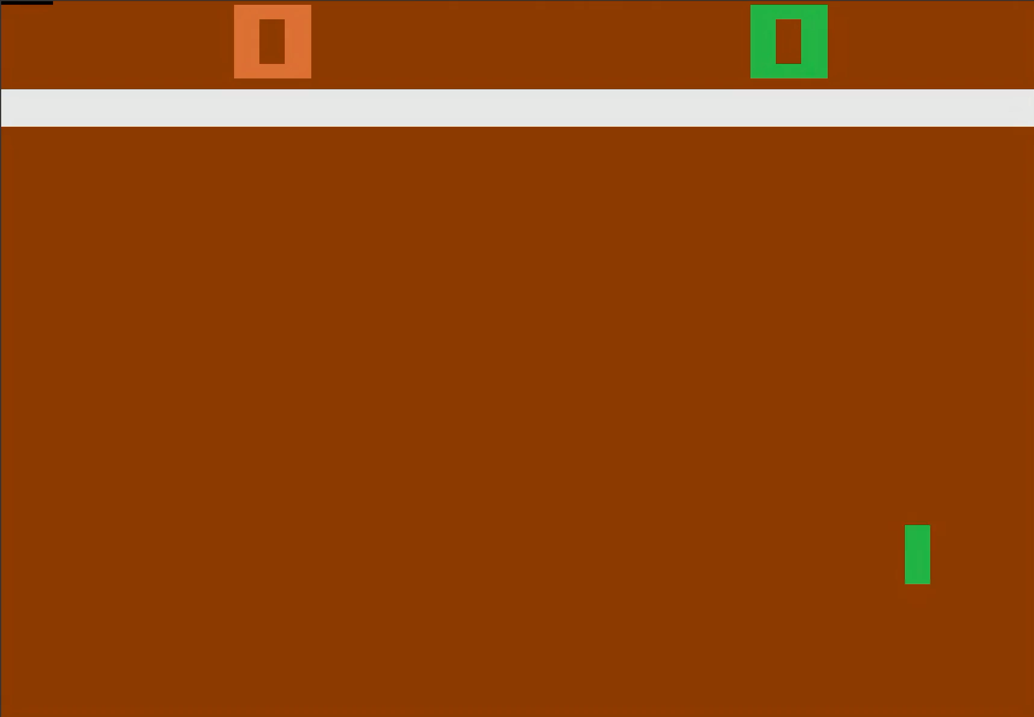
Training
Policy network trained for 3000 episodes
> 5M steps!
Target network updated every 10,000 steps

Slide 7
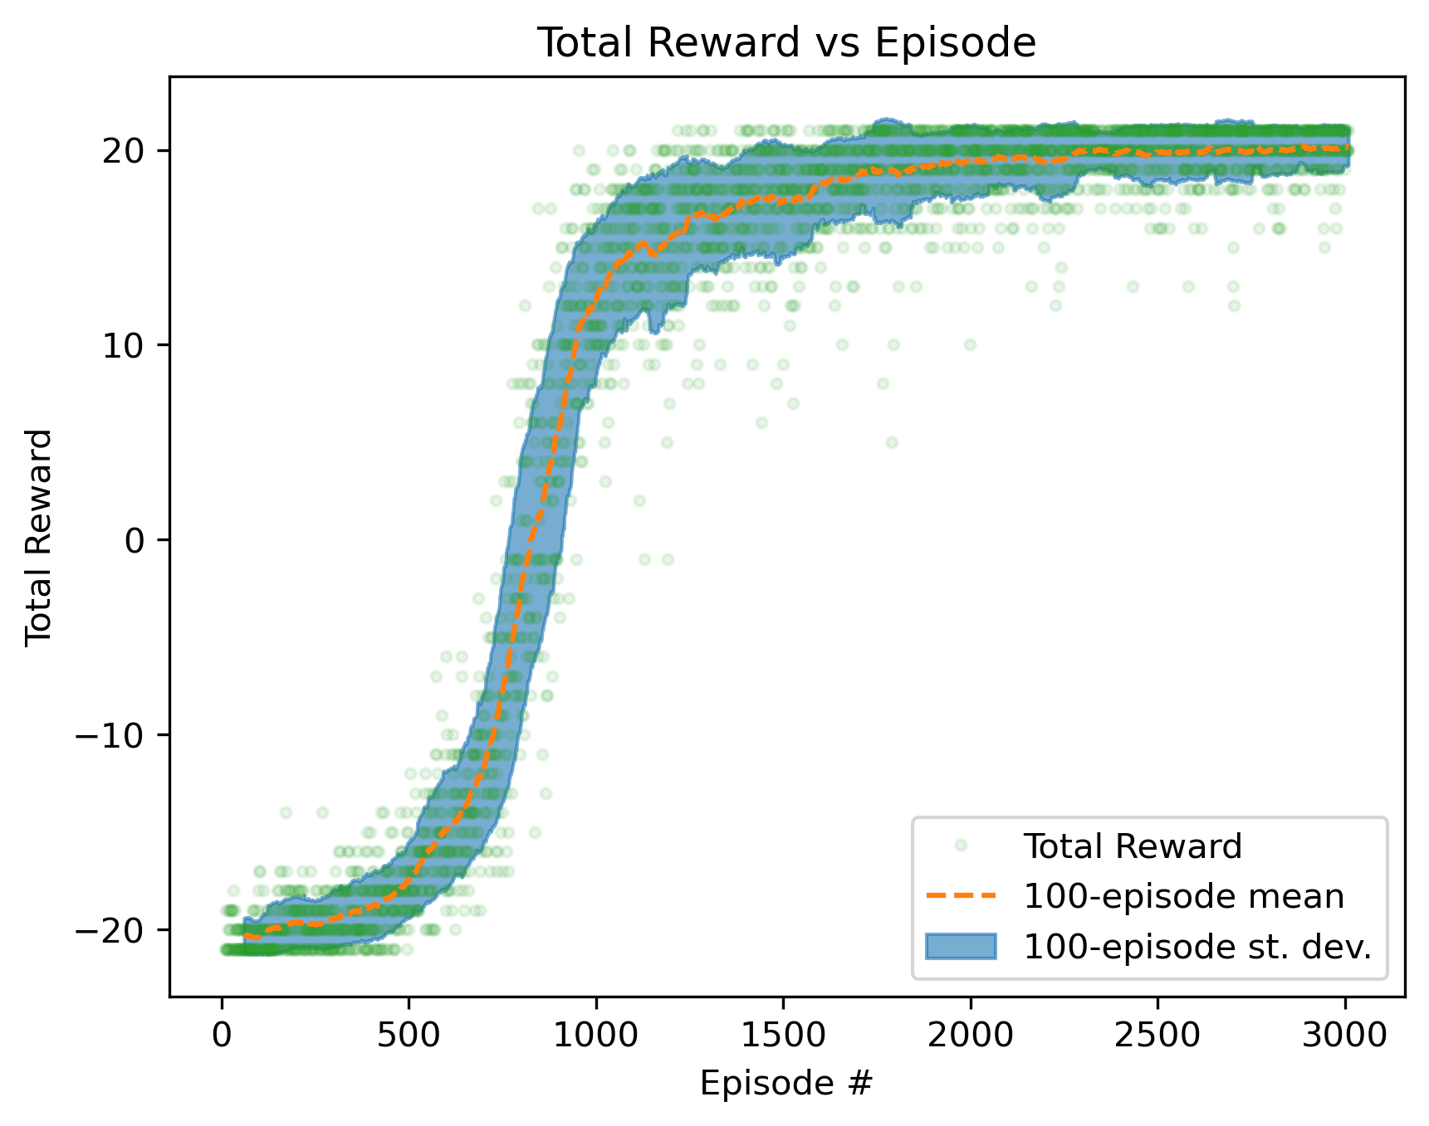
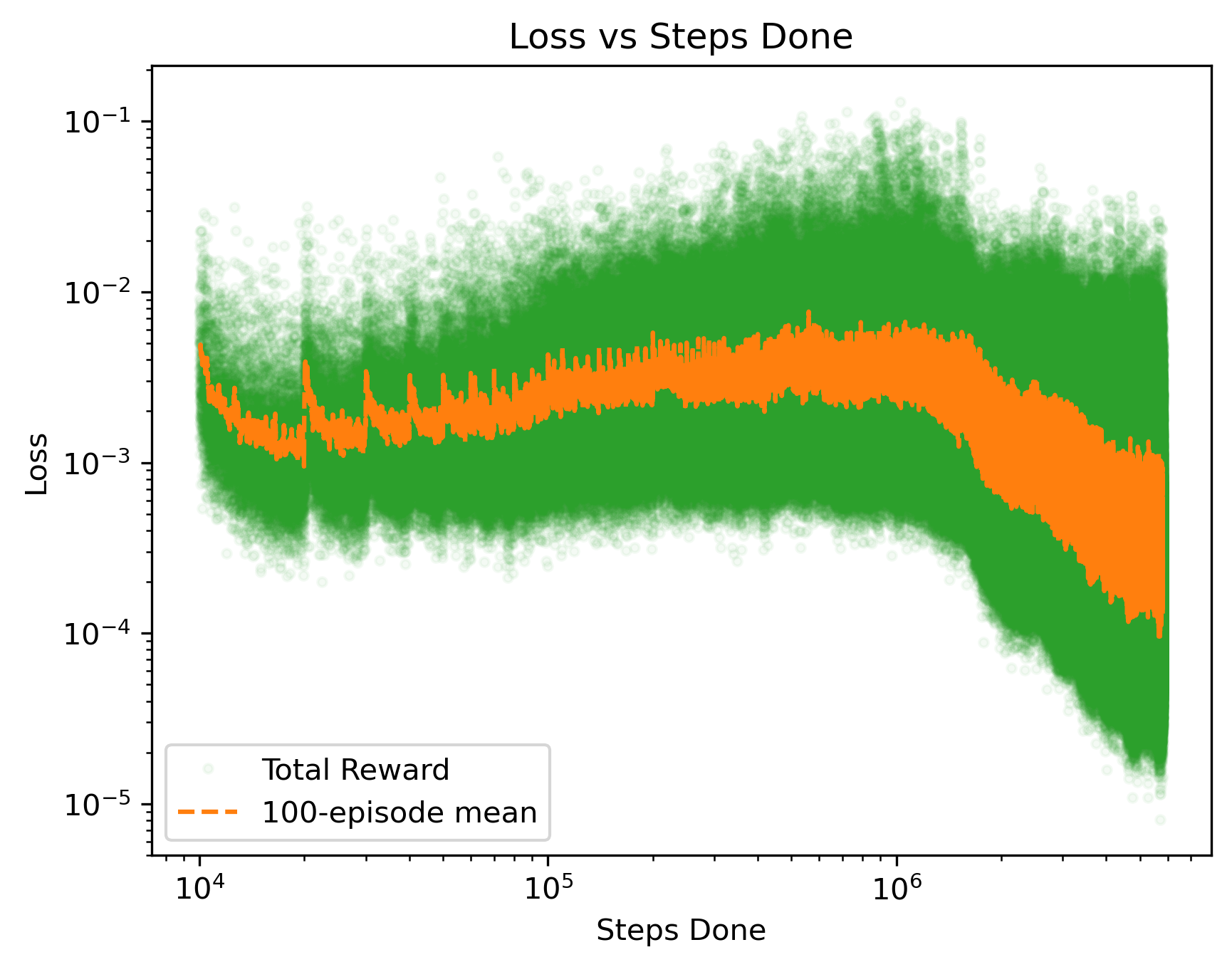
Training

Slide 8
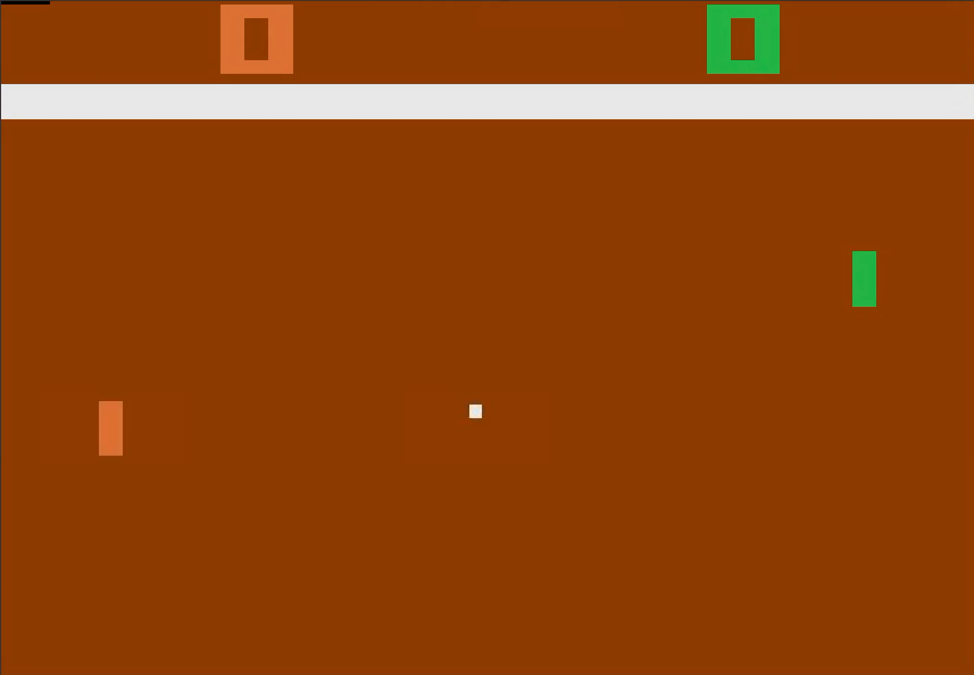
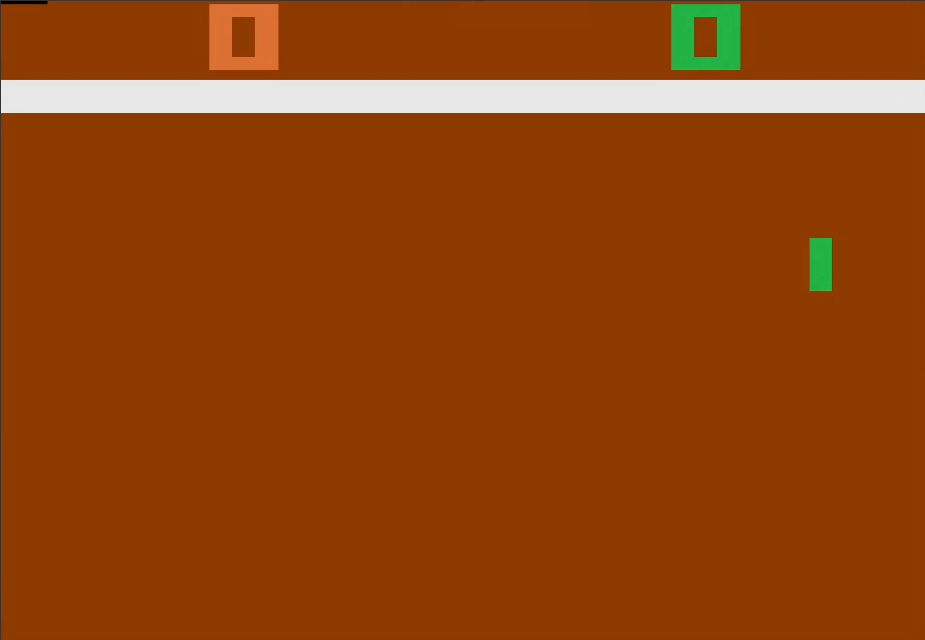
Evaluation

Slide 9
Conclusions and Future Work
DQN is successfully able to learn the OpenAI Atari Pong implementation
3000 episodes is more than enough to get the trained agent to win every game
Nearly enough to get a perfect win on every game
Future Work:
Dependence of different pre-processing techniques (smaller inputs, no frame stacking, etc.)

Slide 10
Questions ?

Slide 11
Backup Slides

Slide 12
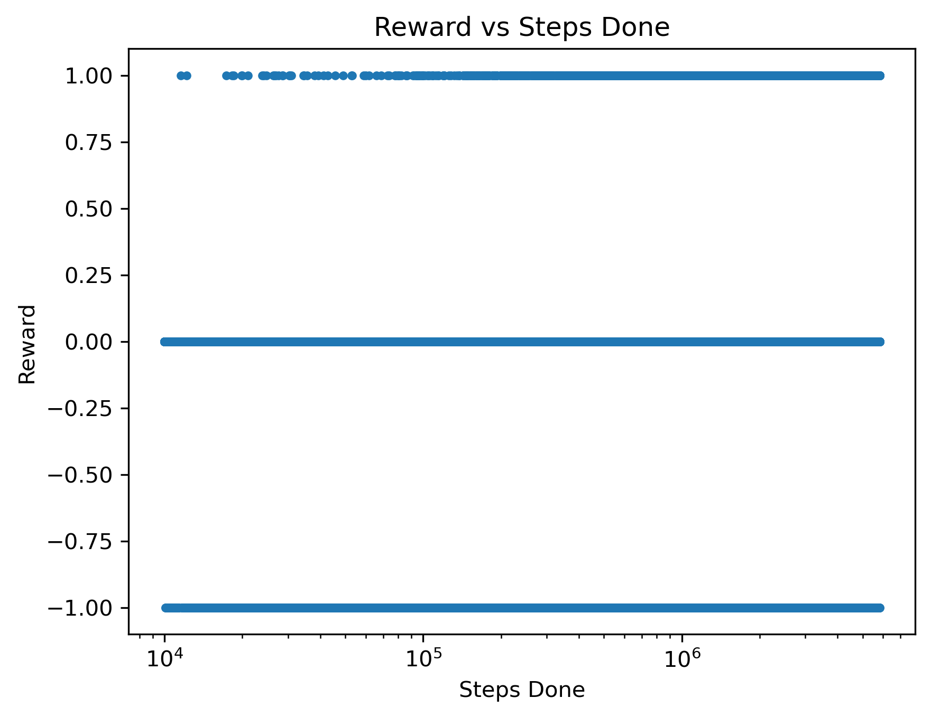
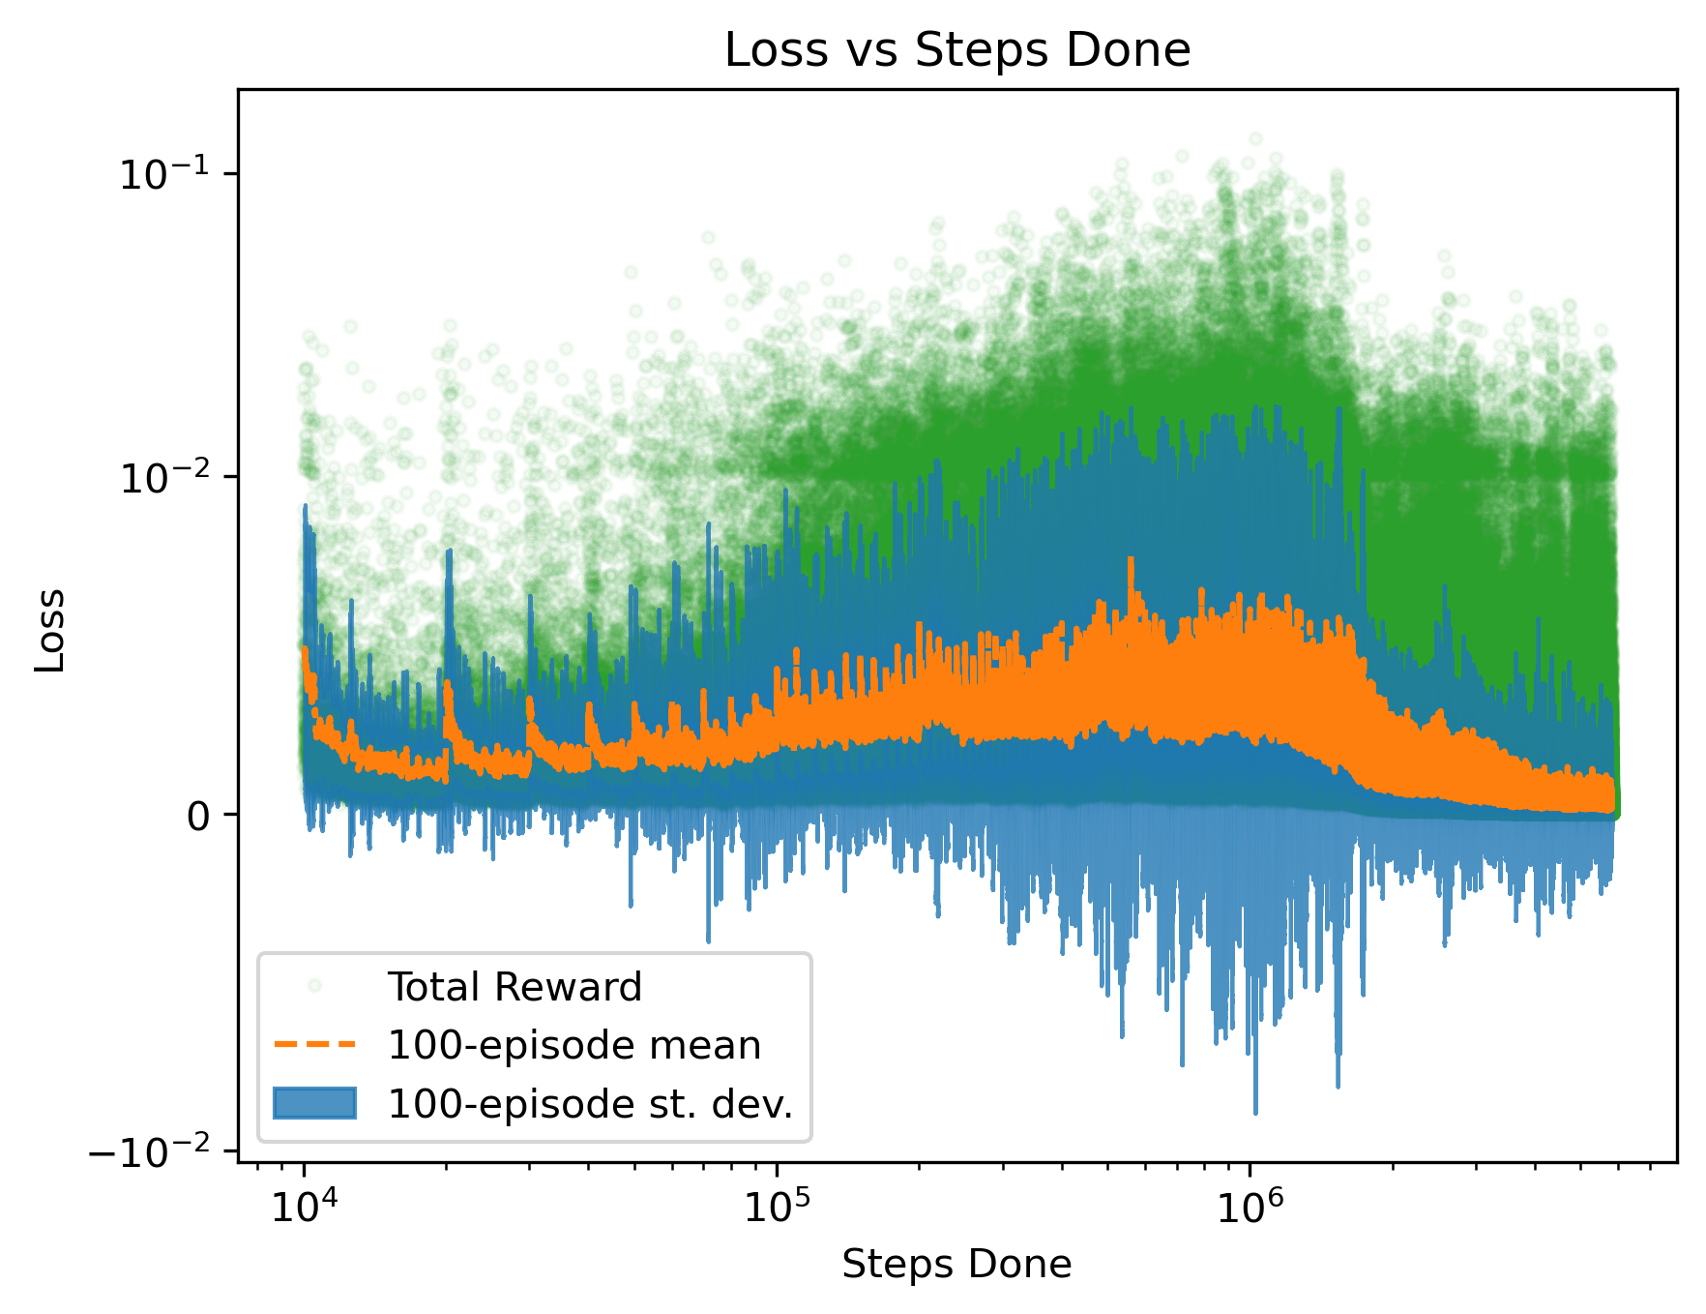
Training – II

